Slide 1

DIGITAL SIGNATURES
CRYPTOGRAPHY COURSE PROJECT

Slide 2
AGENDA
WHAT IS DIGITAL SIGNATURES?
BENEFITS OF DIGITAL SIGNATURES
CRYPTOGRAPHY IN DIGITAL SIGNATURES
TYPES OF DIGITAL SIGNATURES
DIGITAL SIGNATURE IMPLEMANTATION
5.1. RSA
5.2. DSA
5.3. Comparison of Key Features and
Applications of DSA and RSA
6. CONCLUSION

Slide 3
WHAT IS DIGITAL SIGNATURE?
A mathematical method to validate the authenticity and integrity of emails, messages,
documents, or software.
Functions like signing or stamping a document but offers enhanced security.
Provides evidence of origin, identity, and status of electronic documents or transactions.
Signers use it to demonstrate informed consent.
2. BENEFITS OF DIGITAL SIGNATURES
Security: Ensures authenticity and prevents tampering.
Timestamping: Records signature time for time-sensitive cases.
Time-Saving: Speeds up signing and retrieval processes.

Slide 4
3. CRYPTOGRAPHY IN DIGITAL SIGNATURES
Digital signatures authenticate messages using public keys.
Similar to handwritten signatures but applied to digital information.
Links individuals or organizations to digital data, verifiable by recipients or third parties.
Computed using data and a secret key known only to the signer.
Ensures messages are from the claimed sender and prevents disputes, especially in business applications.
Purpose of Digital Signatures
Authentication: Confirms the sender's identity to the receiver.
Non-Repudiation: Prevents the sender from denying having sent the message.
Integrity: Ensures the message was not altered during transmission.

Slide 5
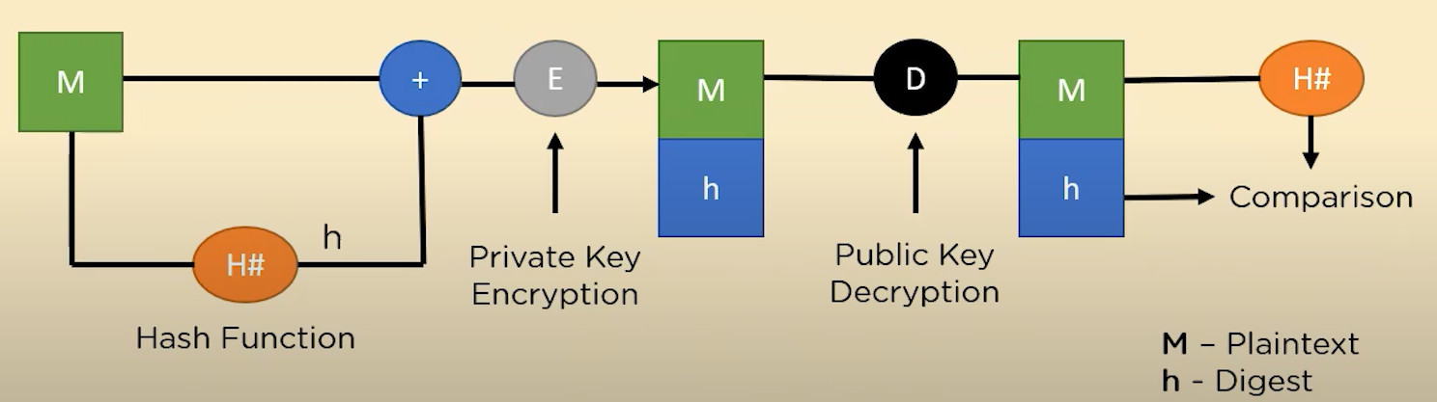
Step 1: The plaintext message (M) is hashed to generate a unique digest (h) ensuring data integrity.
Step 2: The digest is encrypted with the sender's private key (E) to create the digital signature,
which is sent along with the original message.
Step 3: The recipient decrypts the digital signature with the sender's public key (D) to retrieve the digest (h).
Step 4: The recipient re-hashes the plaintext using the same hash function to generate a new digest (H#).
Step 5: If the decrypted digest matches the new digest, the message's integrity and authenticity are confirmed.

Slide 6
4. TYPES OF DIGITAL SIGNATURES
Simple Digital Signature
Not encrypted and lacks legal enforcement.
Does not confirm the signer's origin, making it insecure.
Basic Digital Signature
Similar to a simple digital signature, lacking legal authority.
Does not accurately confirm the sender's identity, and document content may be changed after signing.
Advanced & Qualified Digital Signature
The most secure, legally equivalent to a handwritten signature.
Uses Public Key Infrastructure (PKI) and asymmetric cryptography.
Allows identification of modifications post-signing and specifies the usage, devices, location for signing.
DSA
RSA
5. DIGITAL SIGNATURE IMPLEMANTATION

Slide 7
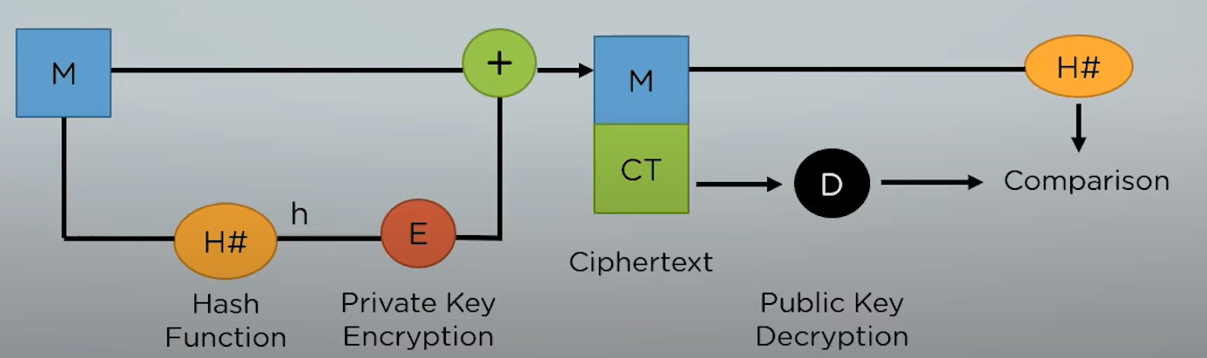
5.1. RSA
Based on asymmetric encryption with a public and private key pair.
Message signing is done with the private key, and verification uses the public key.
Combines hashing and encryption to ensure data authenticity and integrity.
Relies on the difficulty of factoring large prime numbers, making it highly secure

Slide 8
Steps:
A. Key Generation:
a) Two large prime numbers are chosen (p and q).
b) Compute n=p×q and z=(p−1) (q−1).
c) Choose a number e where 1 < e < (p−1) (q−1).
d) A number d is selected so that ed mod z=1 and calculated as d= mod (p−1)(q−1).
e) Public key is (n, e) and private key is (q, d).
B. Encryption and Decryption Function:
a) If the plaintext is m, encrypted ciphertext c is calculated as:
c= m^e mod n
b) Under similar assumptions, the plaintext can be calculated as:
m= c^d mod n

Slide 9
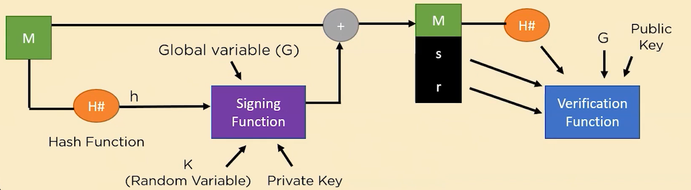
5.2. DSA
Ensures message integrity and validity using public key cryptography.
Signing: Hashes the message and combines it with the private key and a random number.
Verification: Uses the public key to confirm the signature and message authenticity.
Used in secure communications and software distribution.

Slide 10
Steps:
Key Generation
q-> prime divisor
p-> p-1 mod q = 0
a) x -> (private key) -> random integer such that: 0 < x < q
b) y ->(public key) -> can be calculated as: y= g^x mod p
c) G -> any interger g^q mod p=1
2. Signature Generation
a) Message is passed through a hash function to generate a digest (h).
b) Choose any random integer k such that: 0 < k < q.
c) To calculate the value of r: (g^k mod p) mod q
d) To calculate the value of s: [k^(-1) (h+x.r) mod q]
The Signature can be packaged as {r,s}.

Slide 11
3. Signature Verification
a) Calculate the message digest using the same hash function.
b) Compute the value of w such that: s⋅w mod q=1
c) Compute the value of u1 as: u1=h⋅w mod q
d) Compute the value of u2 as: u2=r⋅w mod q
e) Finally, the verification component v: v=[[(g^u1. y^u2 ) mod p) mod q]
If v==r , the signature verification is successful.

Slide 12
5.3. Comparison of Key Features and Applications of DSA and RSA
Feature | DSA | RSA
Advantages | Ensures message authenticity and integrity. | High security due to large key sizes.
Limitations | Weak random number generation affects security. | High computational cost due to large key sizes.
Applications | Secure email protocols (e.g., S/MIME). | Secure transmission in email (e.g., PGP).
 | Blockchain technology and digital certificates. | SSL/TLS for secure web communication.
Digital signatures ensure authenticity, integrity, and non-repudiation in digital communication, enhancing security in online transactions. RSA is widely used for its versatility, while DSA is more efficient for digital signatures but considered less adaptable.
6. CONCLUSION

Slide 13
THANK YOU !
GUNTUR RIDHI
AP22110011467
BTECH – CSE – M
Ridhi_Guntur@srmap.edu.in

